Slide 1

SPRING BEAN SCOPES AND LIFECYCLE

Slide 2


Slide 3
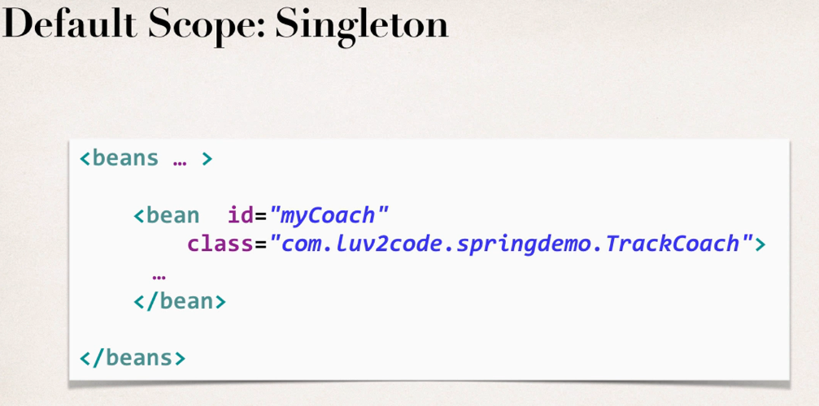
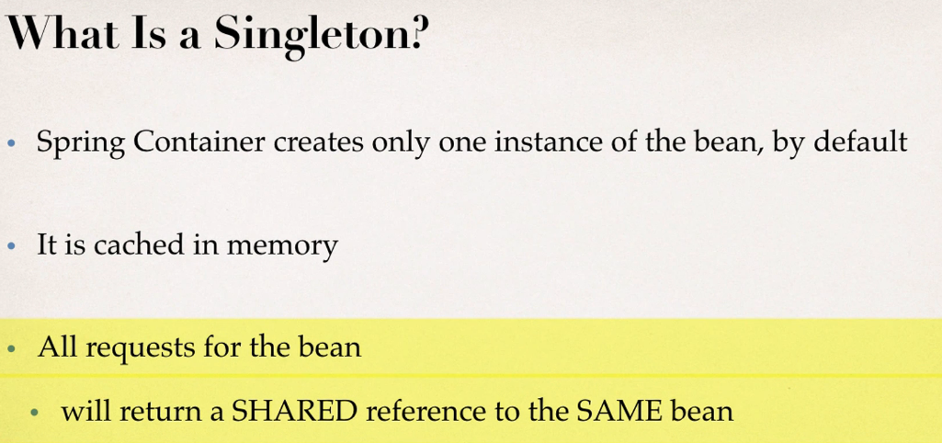
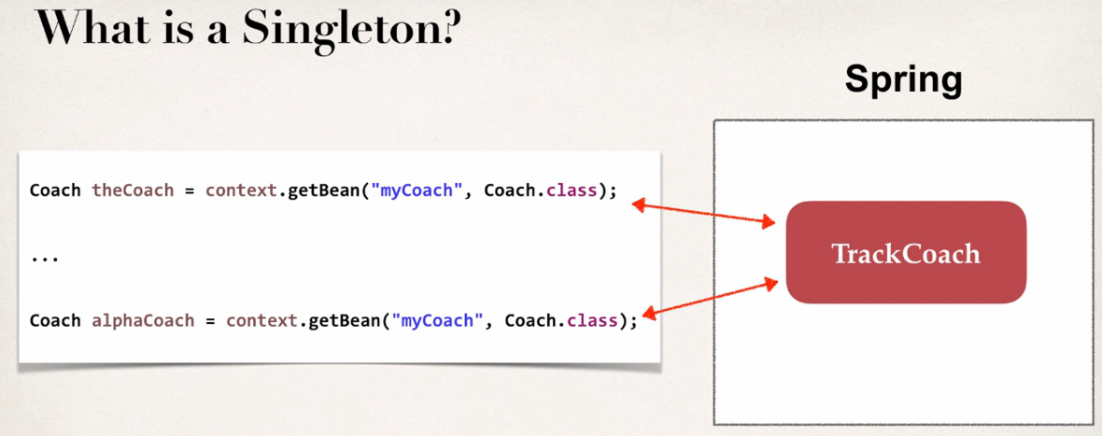
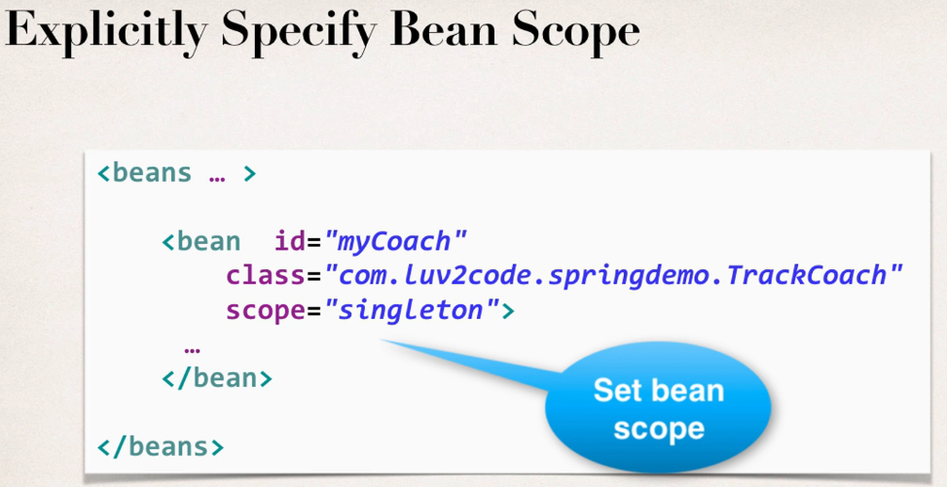
Notes:
Default bean scope is singleton

Slide 4
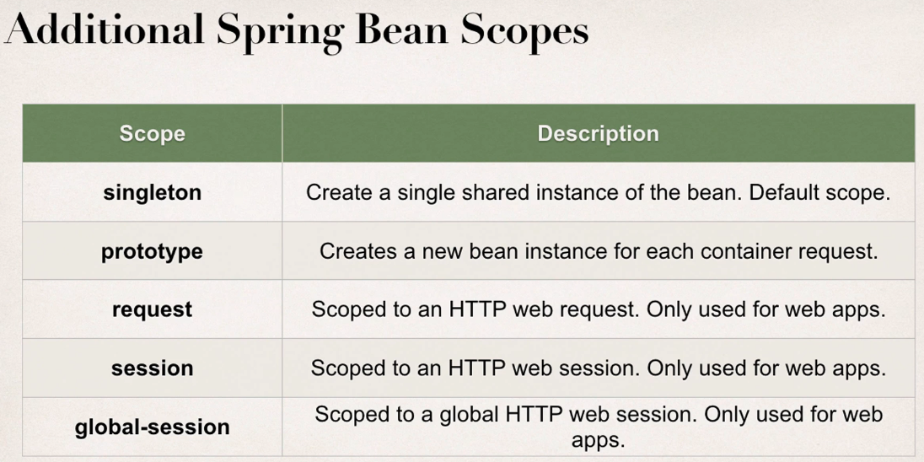

Slide 5
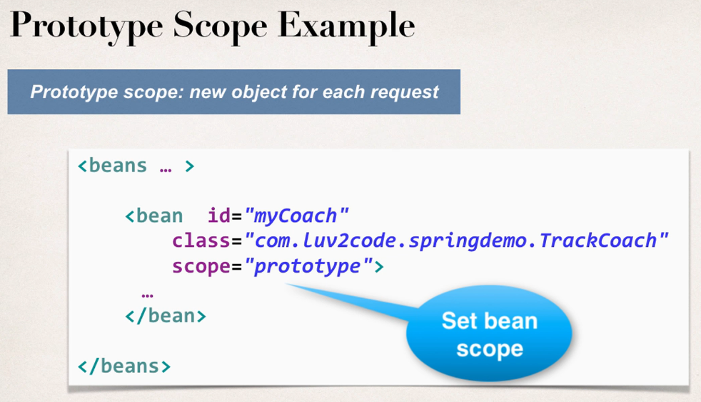
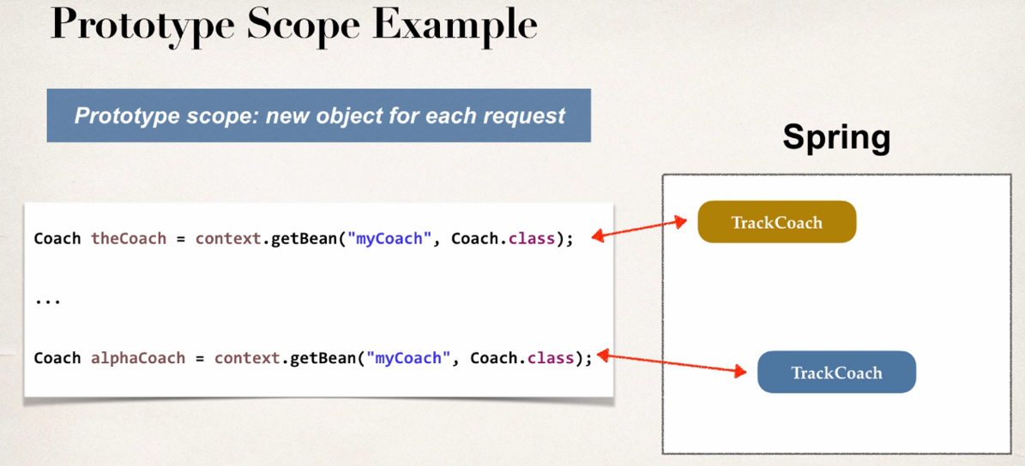

Slide 6
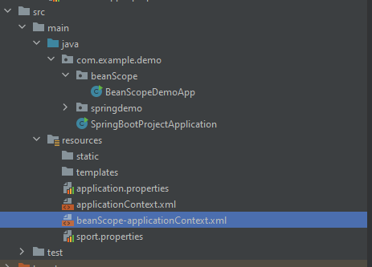
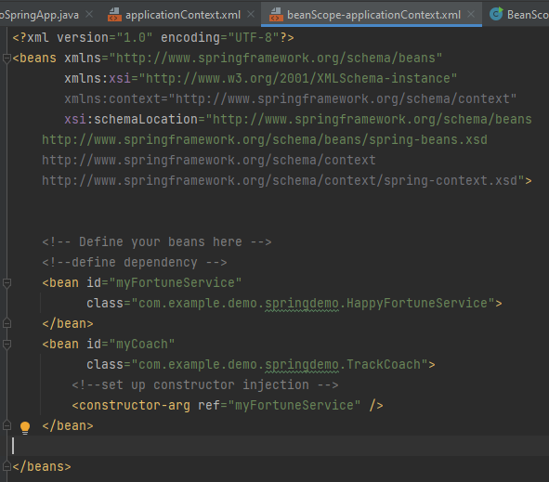
Test with scope="Singleton"
Notes:
Made another package for the bean Scopes i.e. beanScope and for that we have created the separate configuration file i.e. beanScope-applicationContext.xml
We haven’t given any scope in the bean in the second screenshot as the singleton scope is by default get assigned in the spring

Slide 7
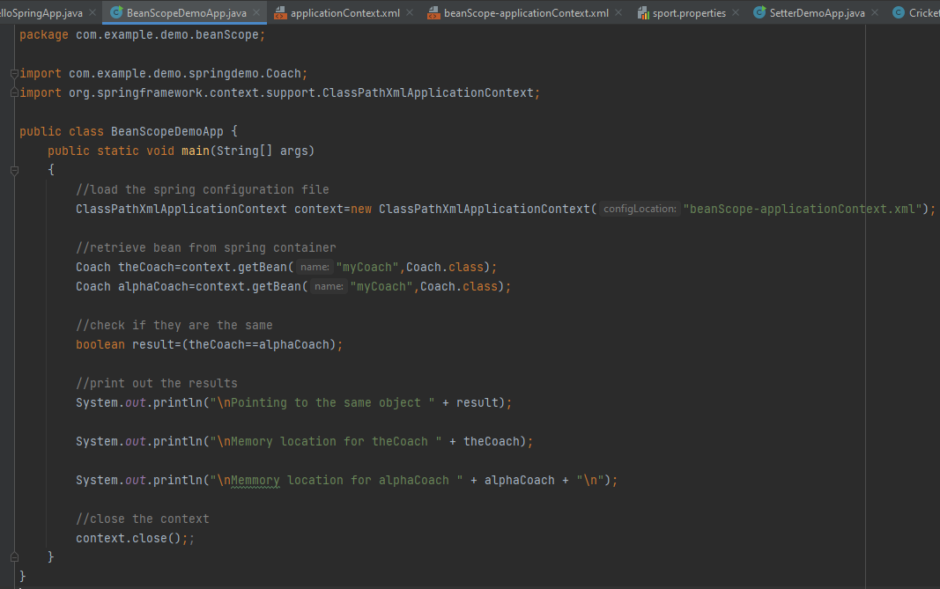
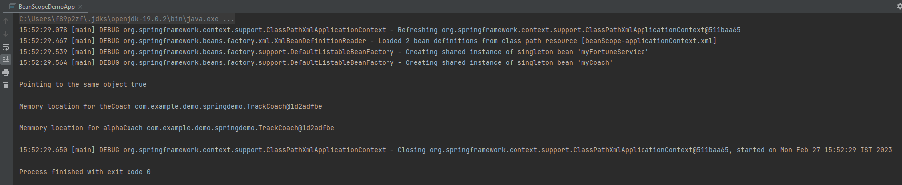
Notes:
We can conclude from the output that theCoach and alphaCoach are same and it is same as the screenshot in slide 3 and also the memory location of both are exactly same,even the address(1d2adfbe)

Slide 8
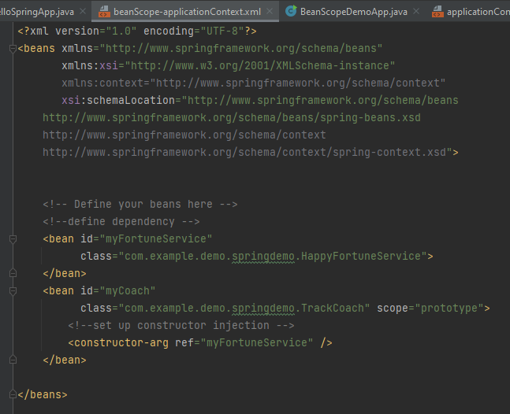
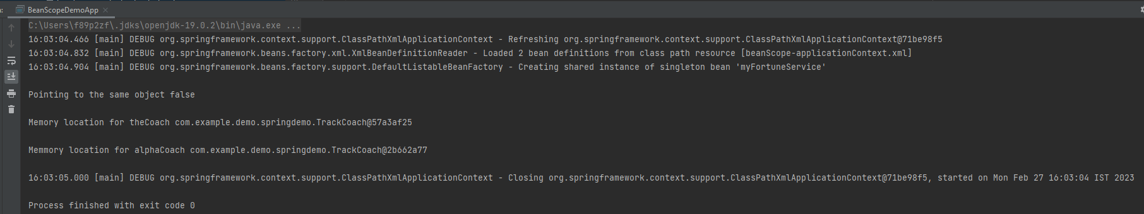
Test with scope=“prototype"
Notes:
BeanScopeDemoApp will be exactly same as in slide 7
So in the above output screenshot we can see that there is new object for each reference(different for theCoach and alphaCoach) i.e. they are getting stored in different memory location, which is same as expected from the slide 5.

Slide 9
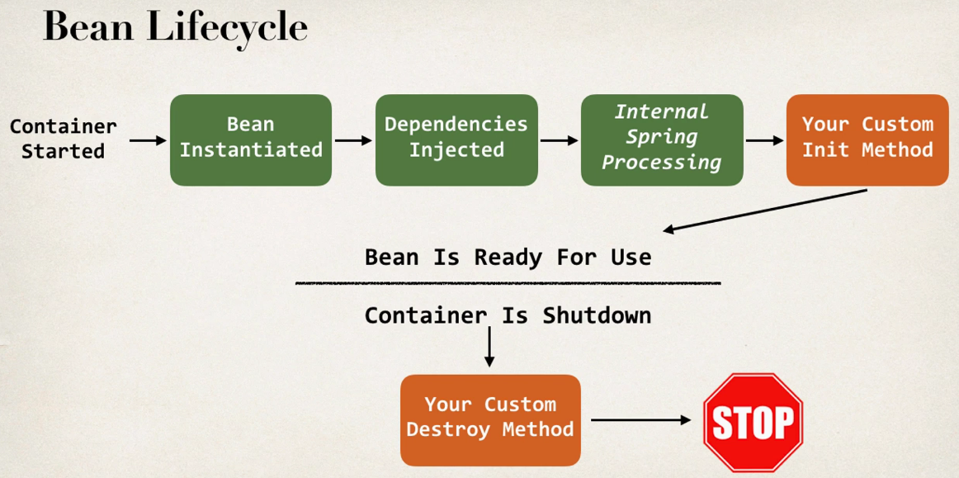
Bean Lifecycle

Slide 10
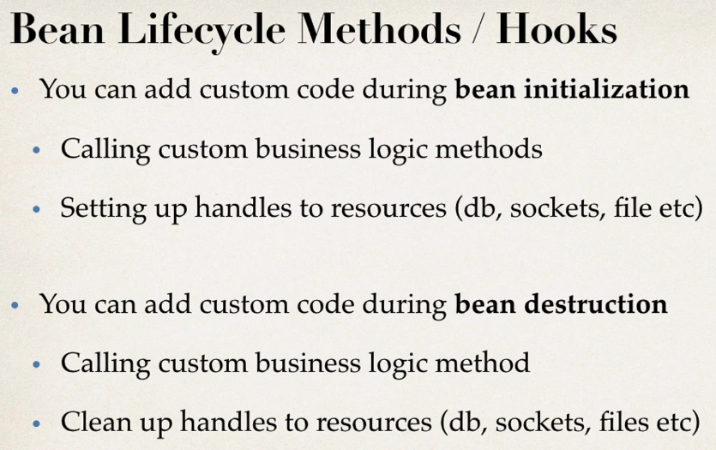

Slide 11
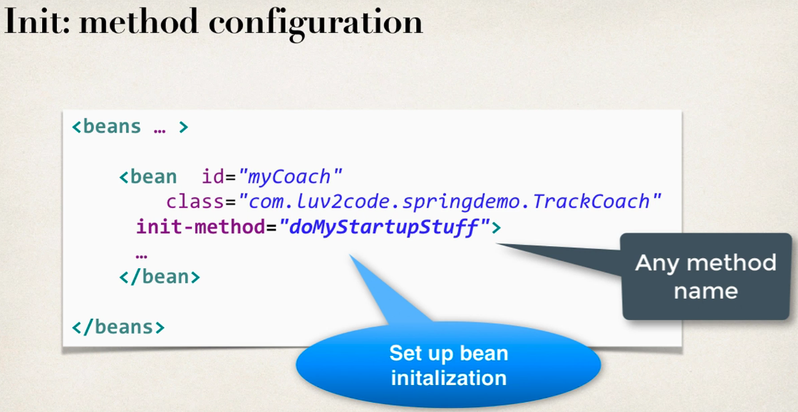
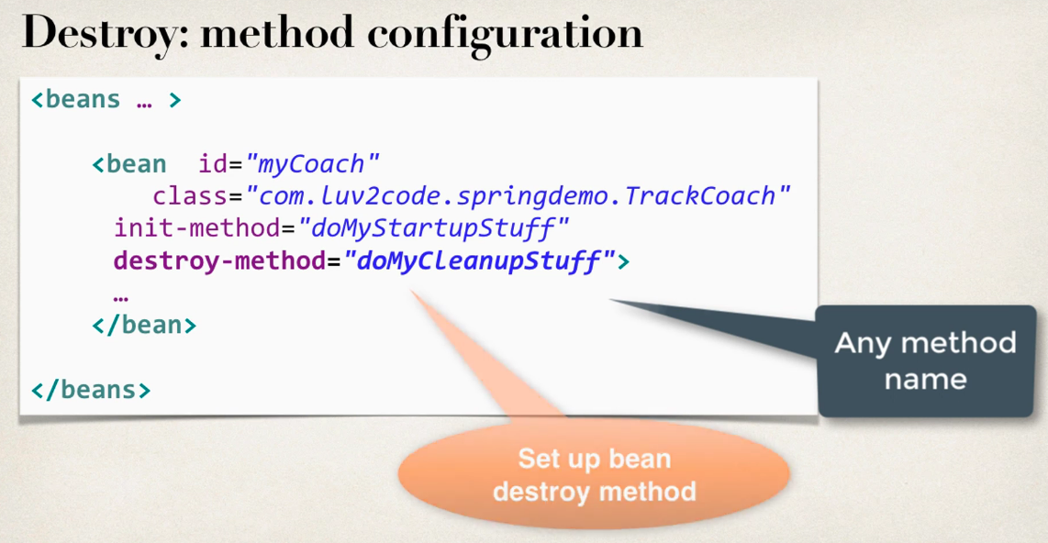

Slide 12
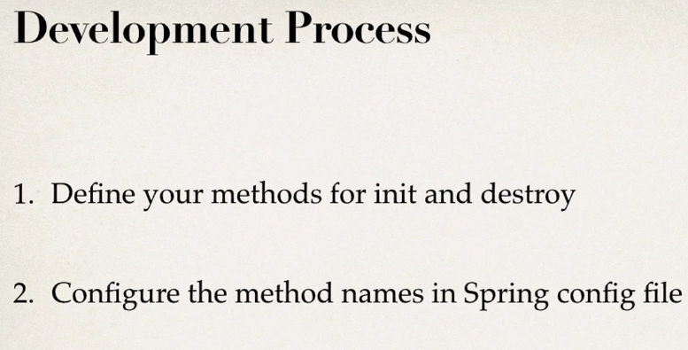
Notes:
Special Note: Defining init and destroy methods - Method Signatures
Special Note about init and destroy Method Signatures
When using XML configuration, I want to provide additional details regarding the method signatures of the init-method and destroy-method .
Access modifier
The method can have any access modifier (public, protected, private)
Return type
The method can have any return type. However, "void' is most commonly used. If you give a return type just note that you will not be able to capture the return value. As a result, "void" is commonly used.
Method name
The method can have any method name.
Arguments
The method can not accept any arguments. The method should be no-arg.

Slide 13
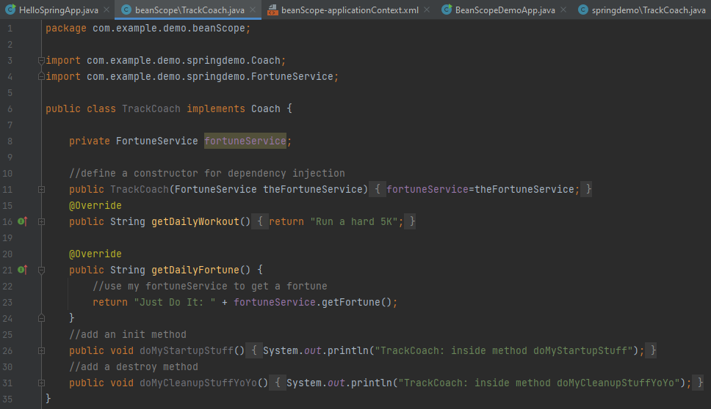
Step - 1 Define your methods for init and destroy

Slide 14
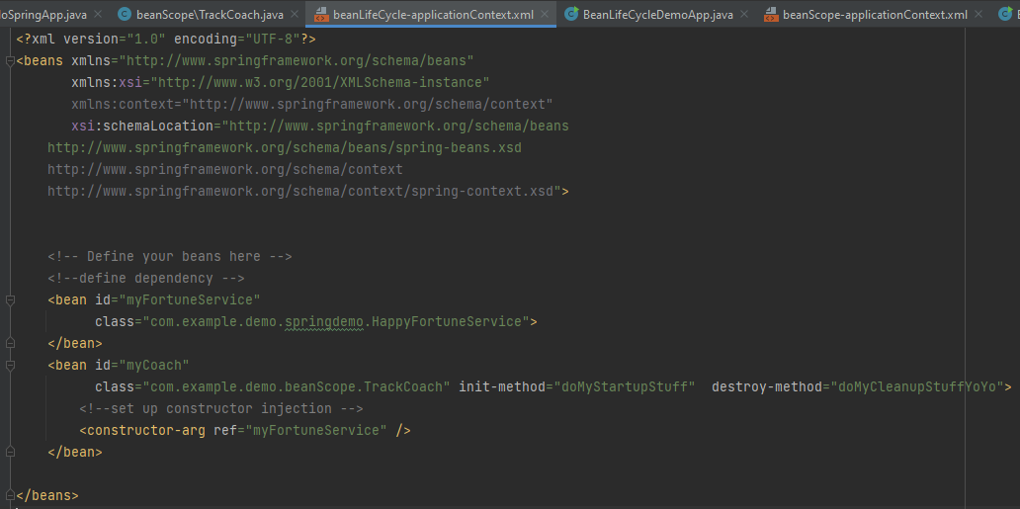
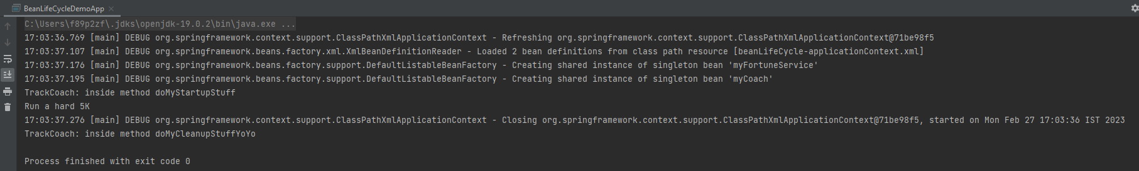
Step - 2 Configure the method names in spring config file
Notes:
Make sure that the class must be correct in the above bean.
In the above screenshot of the output we can see that the bean container gets first instantiated then the output got printed which was there in getDailyWorkout() method and bean container gets closed and then doMyCleanupStuffYoYo()
Output got printed
Special Note about Destroy Lifecycle and Prototype Scope
There is a subtle point you need to be aware of with "prototype" scoped beans.
For "prototype" scoped beans, Spring does not call the destroy method. Gasp!
---
In contrast to the other scopes, Spring does not manage the complete lifecycle of a prototype bean: the container instantiates, configures, and otherwise assembles a prototype object, and hands it to the client, with no further record of that prototype instance.
Thus, although initialization lifecycle callback methods are called on all objects regardless of scope, in the case of prototypes, configured destruction lifecycle callbacks are not called. The client code must clean up prototype-scoped objects and release expensive resources that the prototype bean(s) are holding.

Slide 15
How can I create code to call the destroy method on prototype scope beans
Development Process
1. Create a custom bean processor. This bean processor will keep track of prototype scoped beans. During shutdown it will call the destroy() method on the prototype scoped beans. The custom processor is configured in the spring config file.
<!-- Bean custom processor to handle calling destroy methods on prototype scoped beans -->
<bean id="customProcessor"
class="com.luv2code.springdemo.MyCustomBeanProcessor">
</bean>
2. The prototype scoped beans MUST implement the DisposableBean interface. This interface defines a "destroy()" method.
public class TrackCoach implements Coach, DisposableBean {
...
// add a destroy method
@Override
public void destroy() throws Exception {
System.out.println("TrackCoach: inside method doMyCleanupStuffYoYo");
}
}

Slide 16
3. The Spring configuration does not require use the destroy-method attribute. You can safely remove it.
<bean id="myCoach"
class="com.luv2code.springdemo.TrackCoach"
init-method="doMyStartupStuff"
scope="prototype">
<!-- set up constructor injection -->
<constructor-arg ref="myFortuneService" />
</bean>
4. In this app, BeanLifeCycleDemoApp.java is the main program. TrackCoach.java is the prototype scoped bean. TrackCoach implements the DisposableBean interface and provides the destroy() method. The custom bean processing is handled in the MyCustomBeanProcessor class.

Slide 17
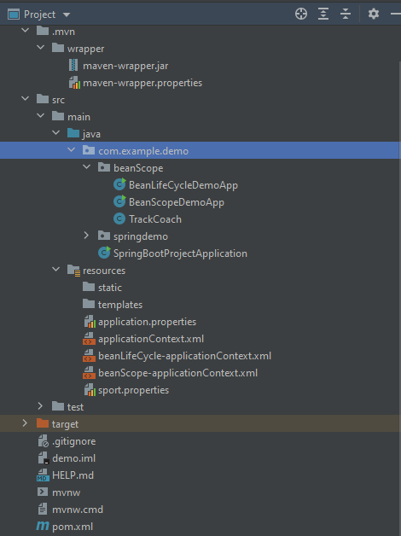
Final Project Structure

Slide 18

Thank You
RAVI.PRAKASH2@FISERV.com

